Slide 1


NEW YORK AIRBNB VISUAL AND ANALYTICAL PRESENTATION
Submitted by-
Abhishek De
Rahul Roy

Slide 2
Agenda
Overview
Objective
Importing necessary libraries and the dataset
Descriptive Statistics for numeric columns
Finding Null Values
Missing Value Treatment
Host Analysis
Analysis of the Neighborhood_group column
Price analysis of property rents

Slide 3
Objective
Improve our shared understanding about the market conditions.
Improve shared understanding about our customers.
Provide recommendations to various departments to be prepared for business expansion.

Slide 4
Overview
Since 2008, guests and hosts have used Airbnb to expand on traveling possibilities and present more unique, personalized way of experiencing the world. This dataset describes the listing activity and metrics in NYC, NY for 2019.
The analytics and visualizations are performed in Python programming language using packages like NumPy, Pandas, Matplotlib and Seaborn.
The different leaders at Airbnb want to understand some important insights based on various attributes in the dataset so as to increase the revenue.

Slide 5

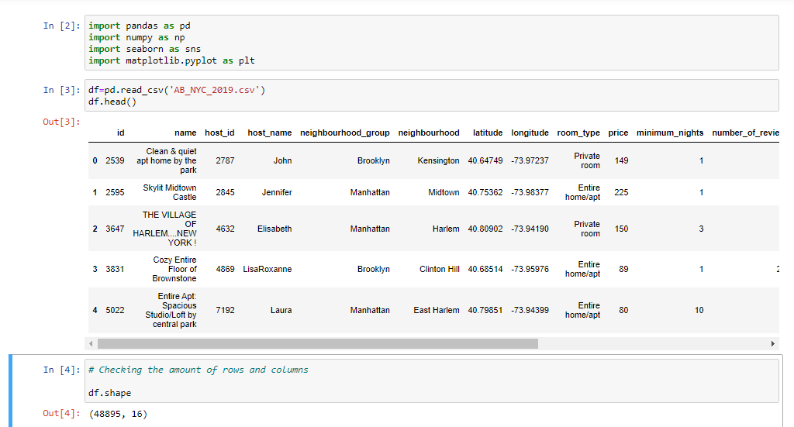
Importing necessary libraries and the dataset
Looking at the dataset we find that the data is contained in 48,895 rows and 16 columns. df.head() function is used to visualise any pandas dataframe’s first 5 rows.

Slide 6
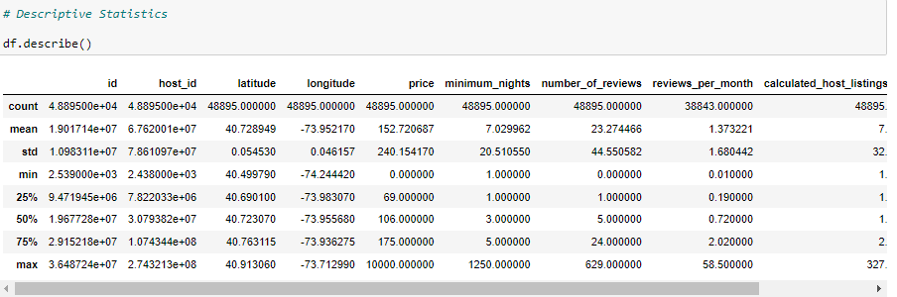
Descriptive Statistics for numeric columns
From the above we can observe the Mean, Median and Maximum values of numeric columns.

Slide 7
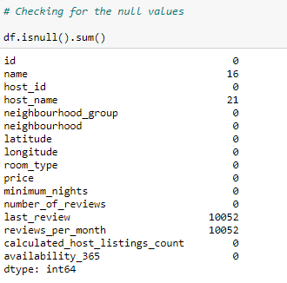
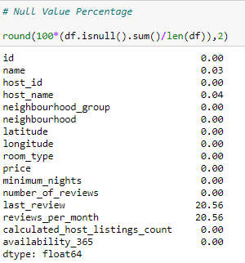
Finding Null Values
df.isnull().sum() is the function which displays the sum of total null or NaN entries in the dataframe. We also depicted percentages of null values.

Slide 8
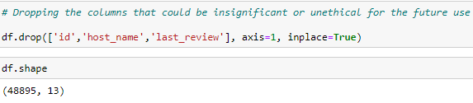

Missing Value Treatment
We dropped the columns which are having missing values and are considered insignificant for your analysis
As the reviews are customer-dependent, it's insignificant to replace the missing values with the mean or median values that's why replacing them with 0

Slide 9
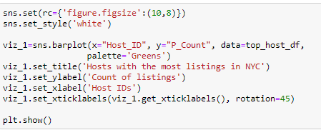
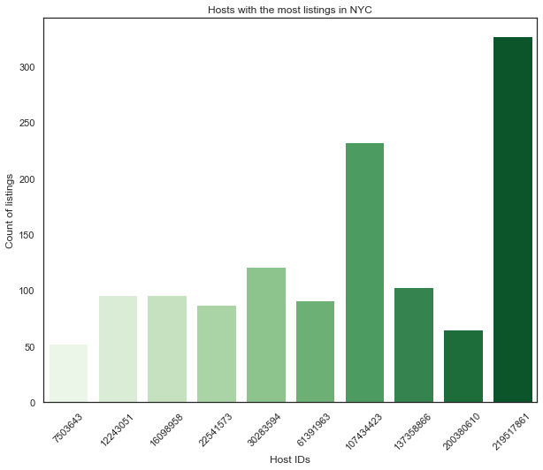
Host Analysis
With the help of Seaborn Barplot, we can visualize the Hosts with the most number of Airbnb property listings in New York City.

Slide 10
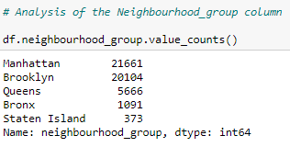
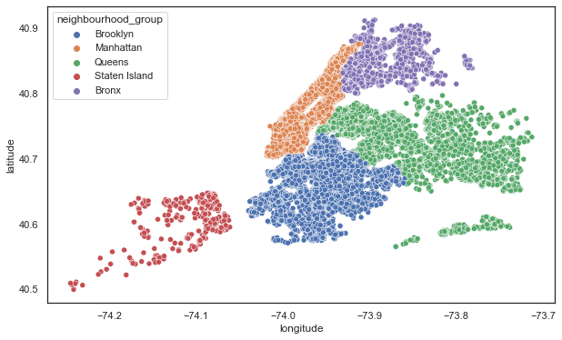
Analysis of the Neighborhood_group column
As evident from the count plot, Manhattan has the highest number of Airbnb holdings in New York (21,661) followed by Brooklyn (20,104), Queens (5,666), Bronx (1,091) and Staten Island (373). Visualising the neighbourhood groups using libraries like seaborn and matplotlib are very handy and can help in building great dashboards and report

Slide 11

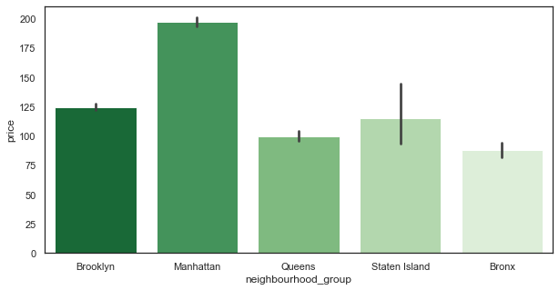
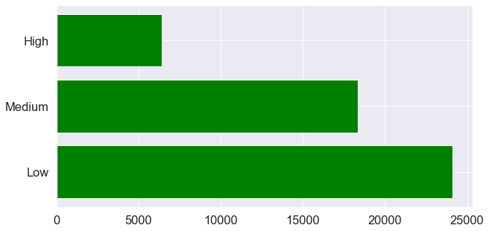
Price analysis of property rents

Slide 12
THANK YOU

